Slide 1
Connected Lighting
Taking light beyond illumination
Bogdan Balaci, Commercial Leader Lighting Philips SEE
October 8th 2015

Slide 2

…A changing worlds needs…
more
connected light
more
energy efficient light
more light
…and we are changing the game.

Slide 3
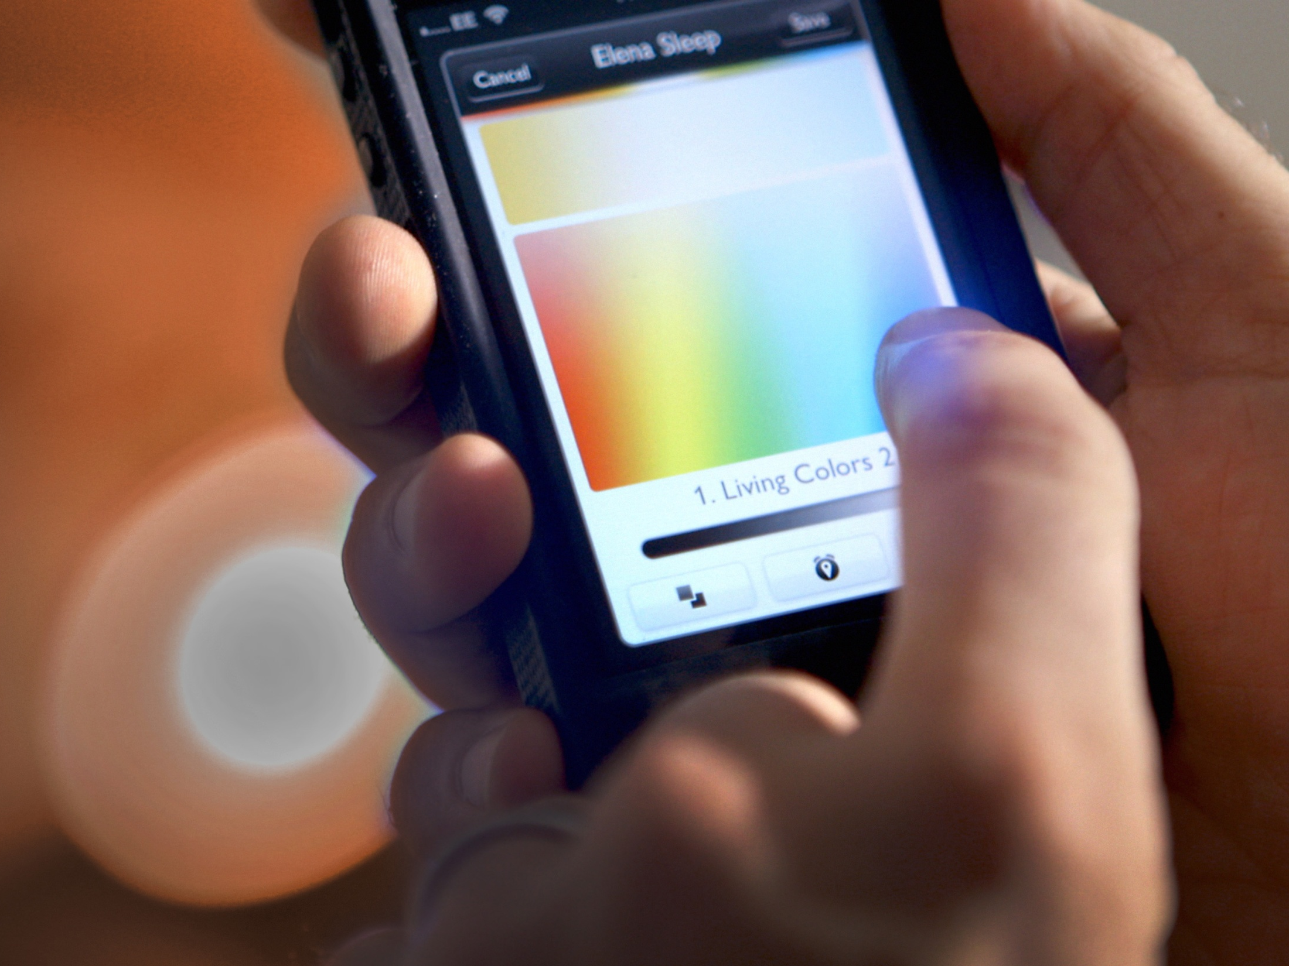
We take light beyond illumination. Today, our ongoing innovation is transforming lighting in the digital age.

Slide 4

The right light for home
Lighting experiences that you create and control
  Served by more than 300 apps, Philips Hue enables people to experience light in new and innovative ways. Lighting to suit your every mood

Slide 5

The right light for offices
Lighting that lowers energy bills and enables you to control your light
With Philips connected lighting, workers can control their office lighting with their smart phone and facility managers can get real-time information on energy use and room occupancy
And Power over Ethernet means one cabling network for lighting and IT, lowering installation costs and facilitating smarter ways of working such as optimizing cleaning routes, maintenance and planning of the office space

Slide 6
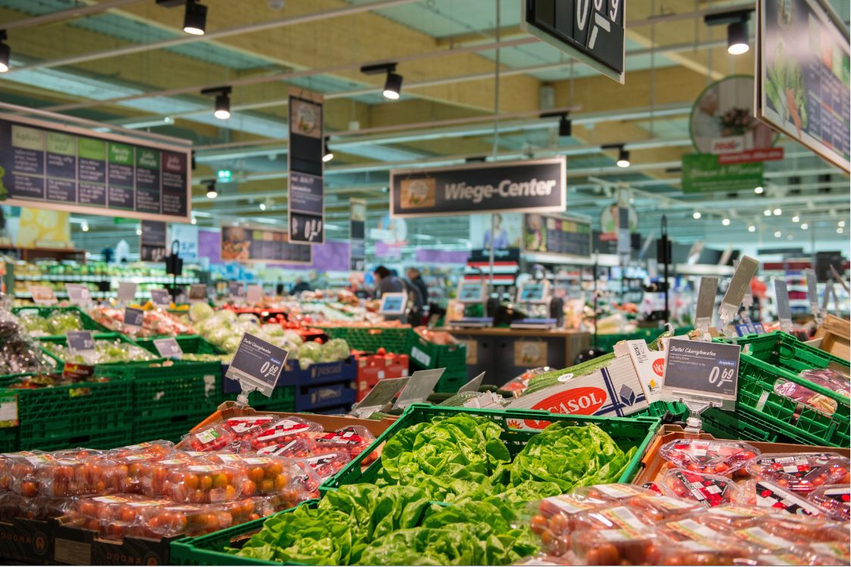

The right light for retail
Lighting that saves energy and gives you a competitive edge
  By integrating wireless communications into the lighting system, you can deliver location-based services and in-context information via mobile apps to people in illuminated spaces.
  Philips LED Indoor positioning technology at Carrefour - VIDEO

Slide 7
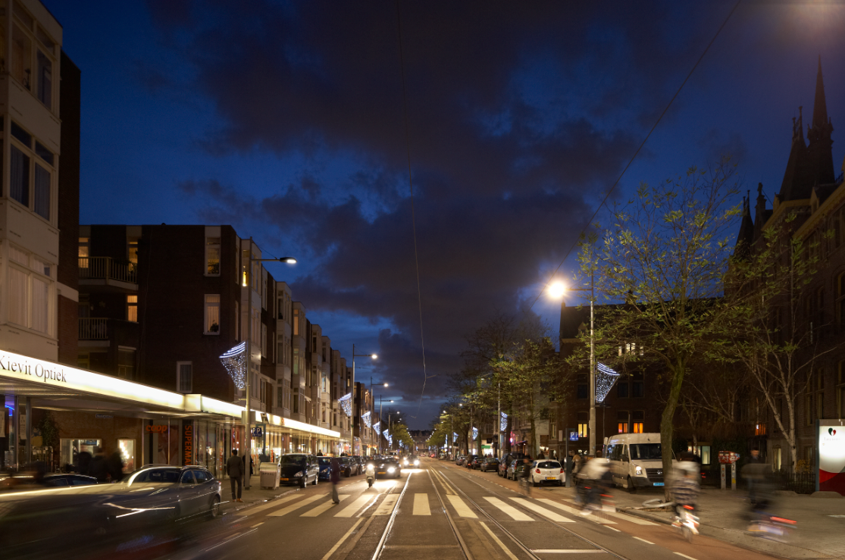
The right light for cities
Lighting for safer, cleaner, more livable cities
Philips’ CityTouch lighting management system, combined with LED technology, delivers energy savings up to 70% compared with conventional lighting
It gives city authorities a visual overview of all street lighting and helps simplify and reduce the cost of commissioning maintenance and management
Notes:
Customer need
No less than one-third of all road lighting worldwide still uses lighting technology dating back to the 1960s. Simply switching to LED lighting can reduce energy consumption by 40% on average, but when combined with sensors, controls and software, a connected street lighting system can realize energy savings of up to 70%.
City authorities want city lighting that is dynamic, and cost- and energy-efficient. However, there are many barriers to sanctioning a widespread overhaul of their lighting infrastructure, not least high up-front costs.
Solution
Philips is driving the lighting industry’s transition toward energy-efficient lighting. Significant savings are possible simply by switching to energy-efficient lighting technologies such as LED. Philips CityTouch allows city authorities to manage all the lighting systems for an entire city from a single, intuitive online user interface. It provides easy, streamlined maintenance and oversight, with real-time status reports for each individual light point. Moreover, it is possible to dim light points outside of peak hours, detect failures and provide smart lighting workflow support.
LED street lighting also enables Philips to provide ‘lighting as a service’ (LaaS). This helps cities to overcome the problem of up-front costs of overhauling their lighting infrastructure, as Philips can help finance the capital investment in new lighting infrastructure which is paid for by the city over time out of energy savings made possible by the LED technology.
Looking to the future, the digital nature of Philips CityTouch combined with LED lighting means that it could be connected to pole-mounted digital sensors and cameras that could provide all manner of services (e.g traffic, safety, security, air quality).
Results / Impact
The Philips CityTouch system enables a city mayor to have a visual overview of the entire street lighting inventory and enables city authorities to make informed decisions and better plan luminaire upgrades
The innovation in the new luminaires removes the need for a local control system and uses GPRS technology to directly connect each luminaire – the hardware – to the Philips City Touch back-end – the software. This reduces costs by removing the need for installing additional hardware. It also dramatically cuts down the commissioning time of every luminaire by directly and automatically connecting every single street light to CityTouch.
The future
Since launching the system in 2012, Philips has completed 262 projects in 31 countries and has plans to launch in North America towards the end of the year.
Philips imagines a future where connected light carries even more information, offering new possibilities and allowing customers to connect all manner of data to provide a full picture of their city. Lighting is not only for illumination, it is truly a service. This is the internet of things. This is the future.
In summary
Energy efficiency
Philips City Touch with LED delivers 70% energy savings over conventional lighting
Operating costs
Reduced maintenance costs by 20% and commissioning time from 8 months to 1 day with plug-and-play Philips CityTouch-ready fixtures
Safety
Citizens reported improved visibility and feeling safer with LED lighting

Slide 8
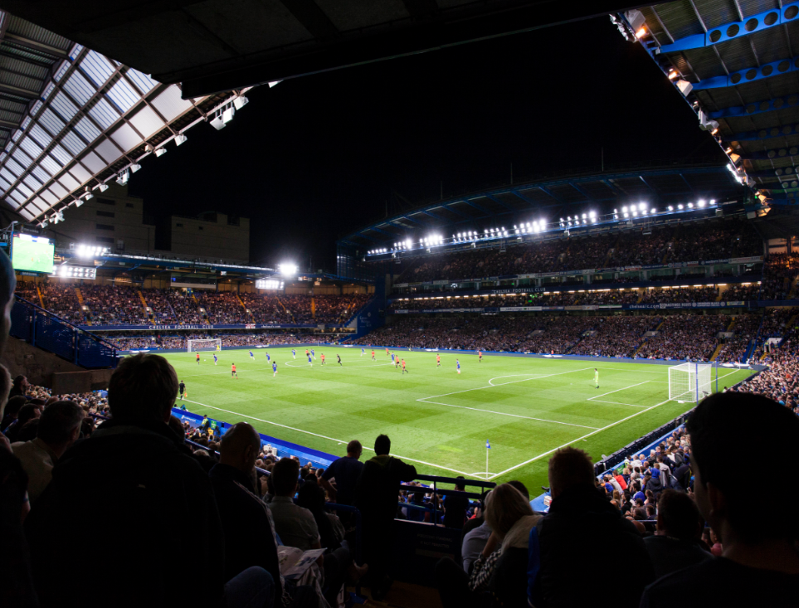
The right light for stadiums
Lighting to delight players, viewers and fans
  Philips ArenaVision LED meets the needs of broadcasters and stadium owners – while at the same time reducing lighting maintenance costs by more than 33%
  Philips façade lighting is able to transform stadiums and enhances the experience for fans

Slide 9
Turning our vision into reality

Slide 10
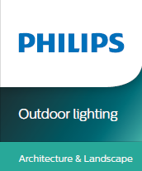
Historical buildings in a new light
Craiova City Center

Slide 11

Historical buildings in a new light
Craiova City Center

Slide 12
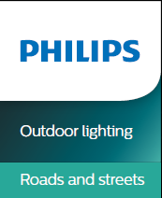
The right lighting solutions for safer roads, Călăraşi

Slide 13
The right lighting solutions for safer roads - Drobeta-Turnu Severin

Slide 14
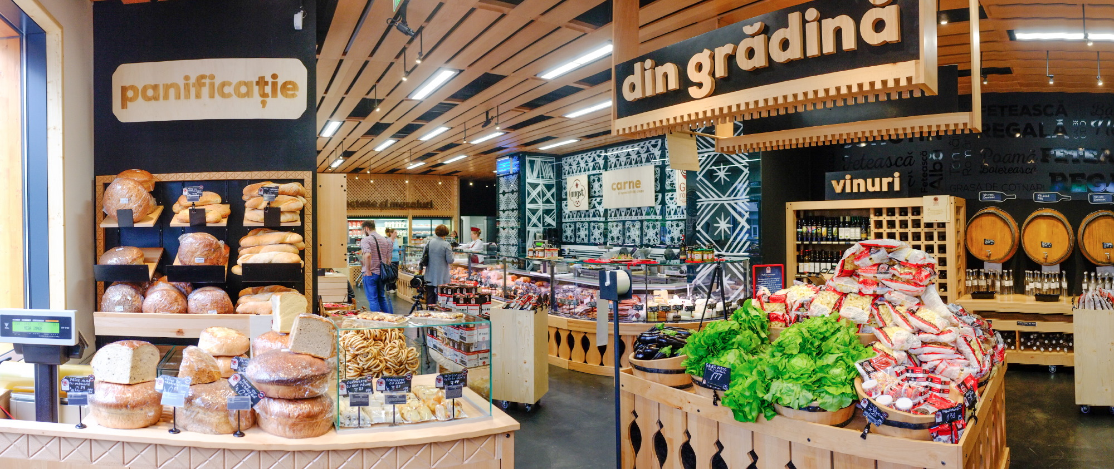
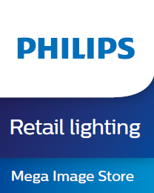
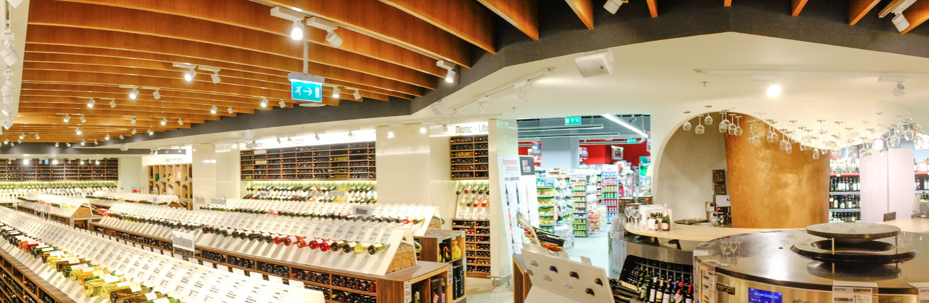

Slide 16
Making a difference in lighting
#1
Hue
  Largest
In LED lighting*
  lighting company in the world
sold in 30 countries,
used in 150,
with more than 300 third party apps
#1
Presence in
60
in
connected lighting**
countries
55%
of world's top footballs stadiums use Philips Lighting
5% of sales in R&D, 32% more than
the nearest competitor
262 Philips CityTouch street lighting implementations in 31 countries
* Source: Internal analysis
** Source: Markets and Markets, Global smart lighting market (2013–18)

Slide 17
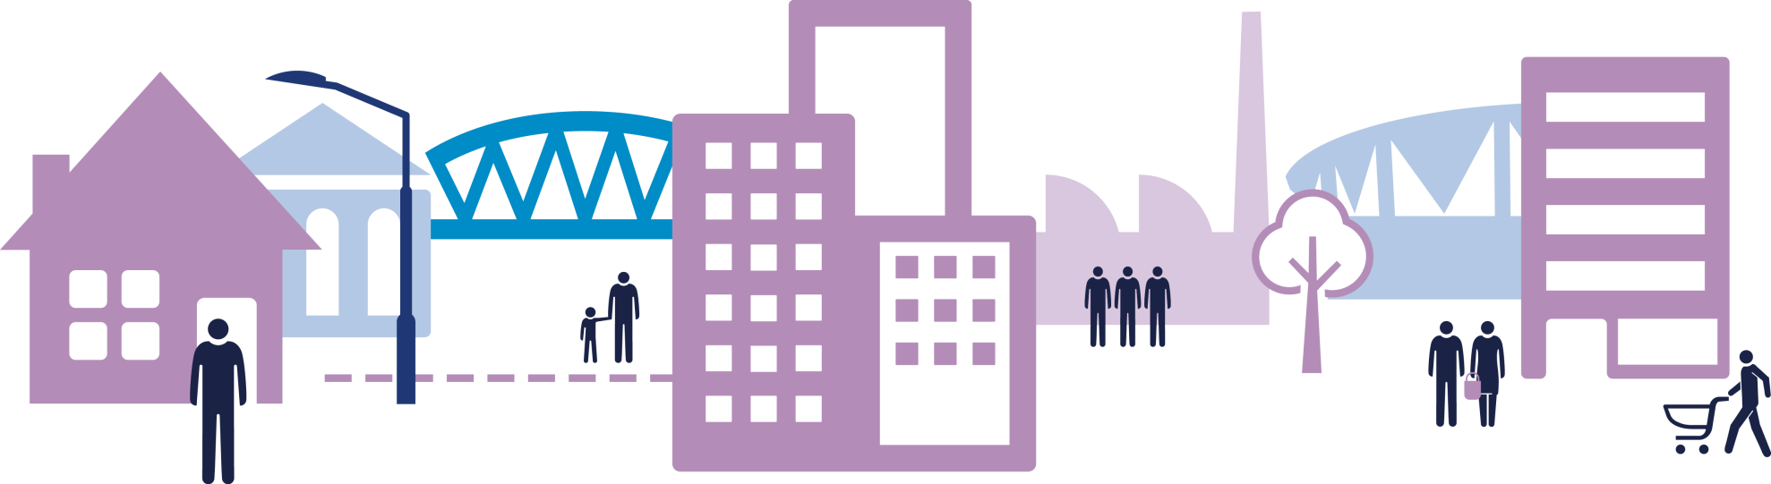
Our unique edge in delivering lighting solutions
Home
Government
Cities
Offices
Industry
Stadiums
Retail
Reducing electricity bills and redefining the space we live in
Empowering a sustainable environment
Creating brighter safer streets, reducing costs and carbon footprint
Helping businesses to reduce energy, work differently and provide new experiences
Improving efficiency and safety and reducing maintenance costs
Enhancing the experience for fans with flexible lighting
Helping retailers drive sales and build customer loyalty

